Slide 1

​Gastric Cancer Image Classification: a Comparative
Analysis and Feature Fusion Strategies
By: Andrea Loddo, Marco Usai, Cecilia di Ruberto

Slide 2
Introduction
Gastric cancer is the fifth most common cancer worldwide and the fourth deadliest.
Creating computational tools that can automatically and accurately perform histopathological diagnoses is essential to address these challenges.
Despite significant research into the disease’s pathobiology, predicting its progression remains difficult, contributing to the persistently low survival rates.
Our goal is to optimize these tools to achieve the most satisfactory results possible.

Slide 3
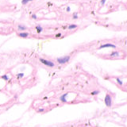
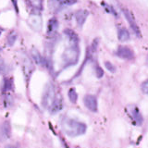
Dataset: GasHisSDB
Divided into three subfolders based on image resolution: 160, 120, 80.
Two different tasks are addressed:
Task 1: Classification of 160x160 images
Task 2: Cross-dataset experimentation
Normal images:
not containing cancerous areas.
Abnormal images:
containing more than 50%
of cancerous areas.

Slide 4
Extracted features
Handcrafted:
Texture:
LBP18
GLCM
Color:
Haar features
Color histogram
Auto-correlogram
Invariant moments:
Zernike moments
First kind Chebishev polynomials
Second kind Chebishev polynomials
Legendre moments
Deep:
DenseNet 201
EfficientNet-b0
AlexNet
DarkNet 53, 19
GoogleNet
Inception-v3
Inception-ResNet-v2
ResNet 101, 50, 18
VGG
Xception

Slide 5
Best results obtained
Features | Classificators | Accuracy | Precision | Recall | Specificity | F-Score | MCC | BACC
Top
handcrafted
feature
 | kNN | 65.24% | 71.84% | 70.09% | 57.79% | 70.95% | 27.71% | 63.94%
 | SVM | 72.51% | 71.57% | 90.60% | 44.72% | 79.97% | 40.82% | 67.66%
CHd6 | Random Forest | 78.11% | 79.66% | 85.76% | 66.36% | 82.60% | 53.48% | 76.06%
 | Fine Tree | 70.47% | 75.94% | 75.00% | 63.50% | 75.47% | 38.38% | 69.25%
 | Ensemble | 80.14% | 81.88% | 86.31% | 70.67% | 84.04% | 57.95% | 78.49%
Features | Classificators | Accuracy | Precision | Recall | Specificity | F-Score | MCC | BACC
 | Ensemble | 40.14% | 61.14% | 3.20% | 96.88% | 6.08% | 0.21% | 50.04%
 | Fine Tree | 84.92% | 87.51% | 87.60% | 80.80% | 87.56% | 68.42% | 84.20%
DenseNet 201 | kNN | 88.21% | 89.04% | 91.84% | 82.63% | 90.42% | 75.16% | 87.23%
 | Random Forest | 91.93% | 92.61% | 94.20% | 88.46% | 93.40% | 83.05% | 91.33%
 | SVM | 94.43% | 95.41% | 95.39% | 92.95% | 95.40% | 88.33% | 94.17%
 | Ensemble | 41.87% | 84.62% | 4.91% | 98.63% | 9.28% | 9.39% | 51.77%
 | Fine Tree | 78.79% | 82.62% | 82.29% | 73.41% | 82.46% | 55.64% | 77.85%
EfficientNet-b0 | kNN | 87.53% | 89.01% | 90.60% | 82.82% | 89.80% | 73.79% | 86.71%
 | Random Forest | 89.89% | 89.96% | 93.77% | 83.92% | 91.83% | 78.71% | 88.85%
 | SVM | 93.84% | 94.69% | 95.16% | 91.81% | 94.93% | 87.09% | 93.49%
Top 2
deep
features

Slide 6
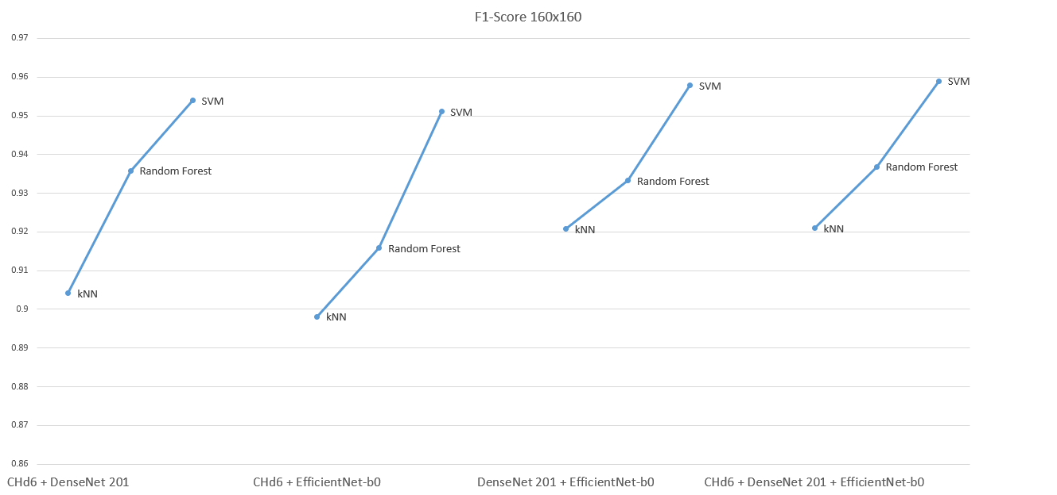
A refinement: combination of features

Slide 7
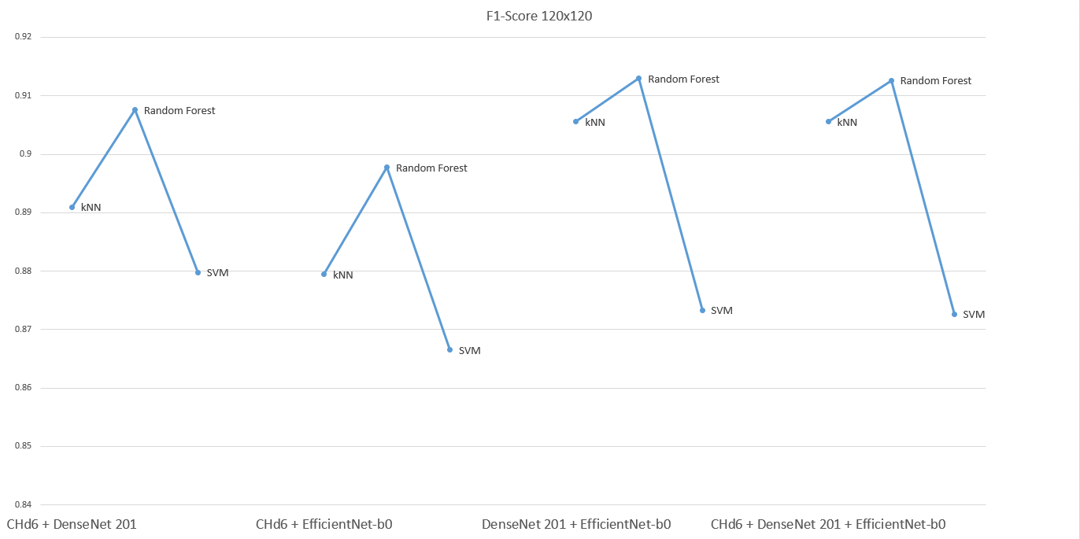
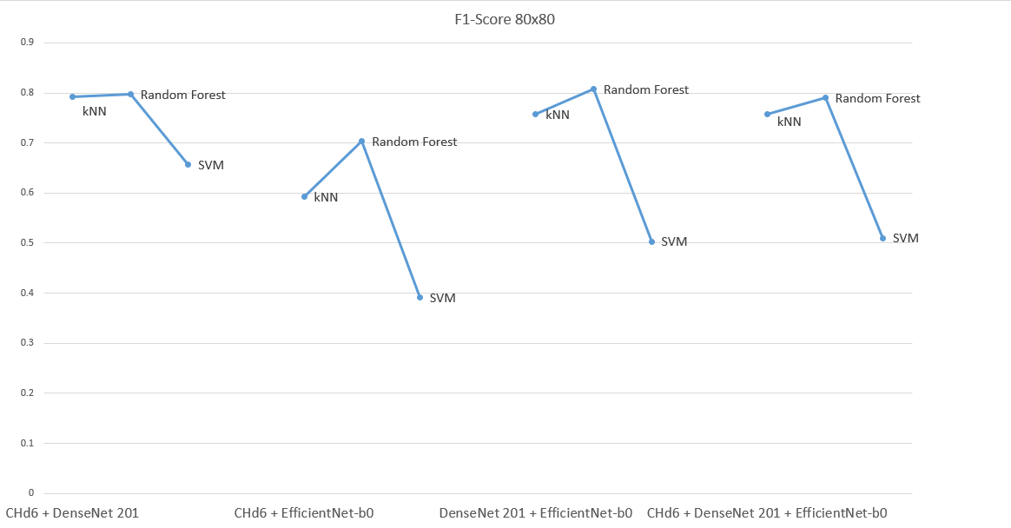
Cross-dataset experimentation
We decided to verify the efficiency of the 160x160 models on datasets with images of different resolutions.
The same models created for 160x160 images were used for 120x120 and 80x80 images.
Remarkable and satisfactory results were achieved for both image datasets.

Slide 8
Conclusions
The most efficient classifier was Random Forest.
Task 1:
Handcrafted: CH, CH2, LM (> 80%);
Deep: DarkNet 53, DenseNet 201, EfficientNet-b0, Inception-ResNet-v2 (> 90%);
Combinations: CHd6-DenseNet 201-EfficientNet-b0 (> 95%)
Task 2:
80x80: > 80%;
120x120: > 90%.
Proposed solution: Random Forest + CHd6-DenseNet 201-EfficientNet-b0

Slide 9
Conclusions
The combination of features has:
improved the overall results;
allowed the establishment of a suitable pipeline for the studied tasks.
The proposed model is reliable for the classification of histopathological images, even in a clinical environment with images of different resolutions.
The state of the art has been improved in the context of the studied dataset.

Slide 10
Future developments
There are multiple future works that can be carried out based on this research.
In particular, the classification will be extended to include additional features and classifiers, incorporating next-generation Vision Transformers.
Additional developments related to the cross-dataset challenge will be conducted through testing and potential refinements on new datasets and different types of staining.

Slide 11

Thank you all for your attention.

